Slide 1
COMP-4770
Final Project -
Nonika Reingold

Slide 2
Animator FSM
AnyState
Flag
Dead
Dying
(again)
Roam
Mind
Capture
Attack
Security

Slide 3
Extra Features
SoldierRoles:
Dead
Collector
Defender
Attacker
Security
Shared Behaviours:
Dying (and Dead)
Roam
Flag
Other:
WeaponPriority
Behaviour -

Slide 4
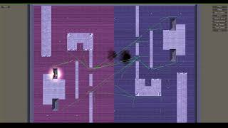

Slide 5
Fun Features
Level Recolor
Pink, Purple, Blue
Silly Variable Names
Soldiers “think” about themselves as “i”
Security thinks of teammate as “friend”
Human-like Gameplay
Not bugs, just features!
Creative -

Slide 6
Animator Controller Tutorial

